Slide 1
Operations Management
William J. Stevenson
8th edition

Slide 2
CHAPTER
11
Inventory
Management
Operations Management, Eighth Edition, by William J. Stevenson
Copyright © 2005 by The McGraw-Hill Companies, Inc. All rights reserved.
McGraw-Hill/Irwin

Slide 3
Inventory: a stock or store of goods
Independent Demand
A
Dependent Demand
B(4)
C(2)
D(2)
E(1)
D(3)
F(2)
Independent demand is uncertain.
Dependent demand is certain.

Slide 4
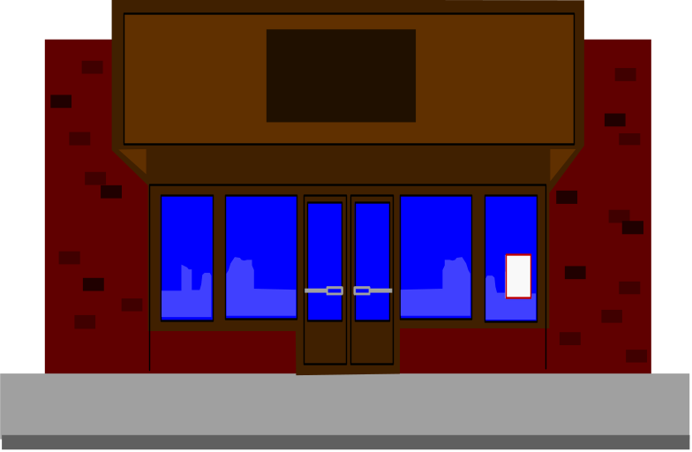
Types of Inventories
Raw materials & purchased parts
Partially completed goods called
work in progress
Finished-goods inventories
  (manufacturing firms)
  or merchandise
  (retail stores)

Slide 5
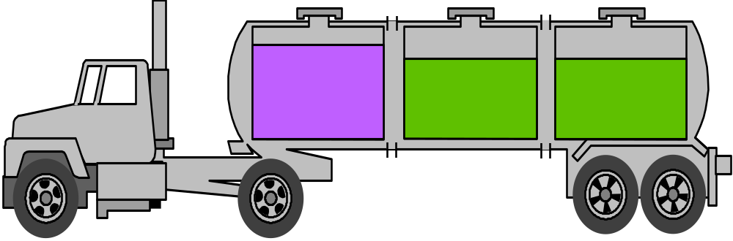
Types of Inventories (Cont’d)
Replacement parts, tools, & supplies
Goods-in-transit to warehouses or customers

Slide 6
Functions of Inventory
To meet anticipated demand
To smooth production requirements
To decouple operations
To protect against stock-outs

Slide 7
Functions of Inventory (Cont’d)
To take advantage of order cycles
To help hedge against price increases
To permit operations
To take advantage of quantity discounts

Slide 8
Objective of Inventory Control
To achieve satisfactory levels of customer service while keeping inventory costs within reasonable bounds
  Level of customer service
  Costs of ordering and carrying inventory

Slide 9
Effective Inventory Management
A system to keep track of inventory
A reliable forecast of demand
Knowledge of lead times
Reasonable estimates of
  Holding costs
  Ordering costs
  Shortage costs
A classification system

Slide 10
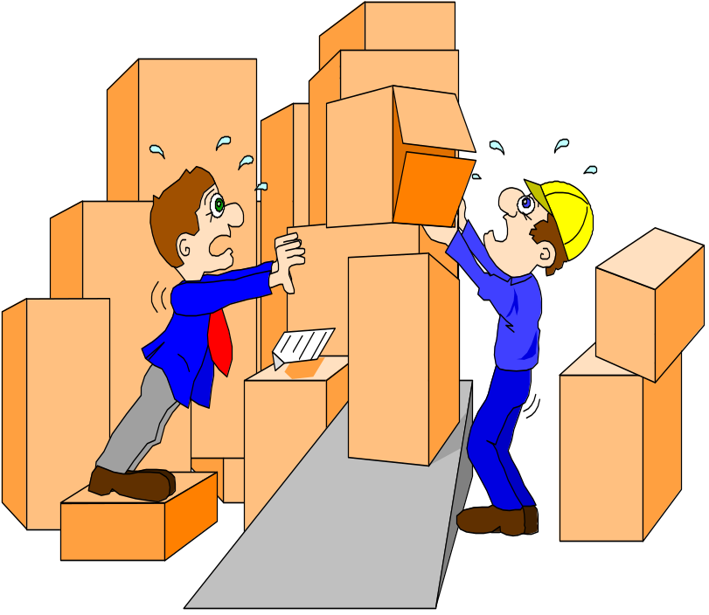
Inventory Counting Systems
Periodic System
  Physical count of items made at periodic intervals
Perpetual Inventory System
System that keeps track
of removals from inventory
continuously, thus
monitoring
current levels of
each item

Slide 11
Inventory Counting Systems (Cont’d)
Two-Bin System - Two containers of inventory; reorder when the first is empty
Universal Bar Code - Bar code
printed on a label that has
information about the item
to which it is attached
0
214800 232087768

Slide 12
Key Inventory Terms
Lead time: time interval between ordering and receiving the order
Holding (carrying) costs: cost to carry an item in inventory for a length of time, usually a year
Ordering costs: costs of ordering and receiving inventory
Shortage costs: costs when demand exceeds supply

Slide 13
INVENTORY CARRYING COST
Inventory carrying cost, or carrying costs, is an accounting term that identifies all business expenses related to holding and storing unsold goods. The total figure would include the related costs of warehousing, salaries, transportation and handling, taxes, and insurance as well as depreciation, shrinkage, and opportunity costs.
The tangible costs of storing inventory such as storage, handling, and insuring goods are obvious. Less obvious are the intangibles such as the opportunity cost of the money that was used to purchase the inventory, and the cost of deterioration and obsolescence of goods in storage.

Slide 14
ABC Classification System
Figure 11.1
Classifying inventory according to some measure of importance and allocating control efforts accordingly.
  A - very important
  B - mod. important
  C - least important
High
A
Annual
$ value
of items
B
C
Low
Few
Many
Number of Items

Slide 15
Cycle Counting
A physical count of items in inventory
Cycle counting management
  How much accuracy is needed?
  When should cycle counting be performed?
  Who should do it?

Slide 16
Economic Order Quantity Models
Economic order quantity model
Economic production model
Quantity discount model

Slide 17
Assumptions of EOQ Model
Only one product is involved
Annual demand requirements known
Demand is even throughout the year
Lead time does not vary
Each order is received in a single delivery
There are no quantity discounts

Slide 18
The Inventory Cycle
Figure 11.2
Profile of Inventory Level Over Time
Q
Usage
rate
Quantity
on hand
Reorder
point
Time
Receive
order
Place
order
Receive
order
Place
order
Receive
order
Lead time

Slide 19
Total Cost
Annual
carrying
cost
Annual
ordering
cost
Total cost =
+
Q
D
TC =
H
+
S
2
Q

Slide 20
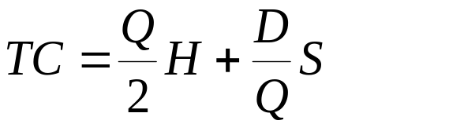
Cost Minimization Goal
Figure 11.4C
The Total-Cost Curve is U-Shaped
Annual Cost
Ordering Costs
Q_{O}
(optimal order quantity)
Order Quantity (Q)

Slide 21
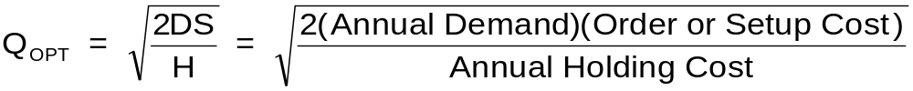
Deriving the EOQ
Using calculus, we take the derivative of the total cost function and set the derivative (slope) equal to zero and solve for Q.

Slide 22
Minimum Total Cost
The total cost curve reaches its minimum where the carrying and ordering costs are equal.

Slide 23
Economic Production Quantity (EPQ)
Production done in batches or lots
Capacity to produce a part exceeds the part’s usage or demand rate
Assumptions of EPQ are similar to EOQ except orders are received incrementally during production

Slide 24
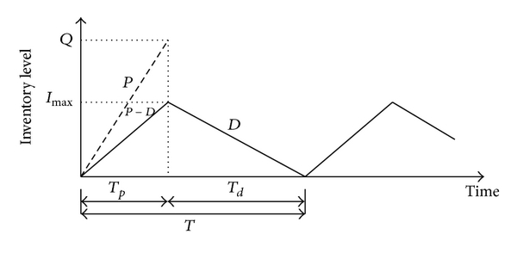

Slide 25
Economic Production Quantity Assumptions
Only one item is involved
Annual demand is known
Usage rate is constant
Usage occurs continually
Production rate is constant
Lead time does not vary
No quantity discounts

Slide 26
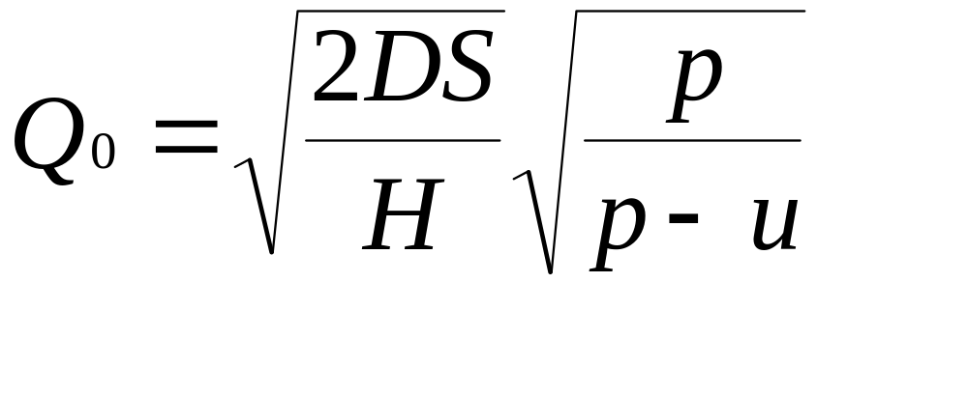
Economic Run Size

Slide 27
PAGE 567- STEVENSON BOOK
The economic run quantity is
Q p = √2 DS/H √p/ p − u
where
p
= Production or delivery rate u = Usage rate
Note: p and u must be in the same units (e.g., both in units per day, or units per week).
The cycle time (the time between setups of consecutive runs) for the economic run size model is a function of the run size and usage (demand) rate:

Slide 28
Cycle time = Q p/ u
Similarly, the run time (the production phase of the cycle) is a function of the run (lot) size
and the production rate:
Run time = Q p/ p
The maximum and average inventory levels are
I max = Q p/ p (p − u)
Ia verage = Im ax/ 2

Slide 29
Total Costs with Purchasing Cost
Annual
carrying
cost
Annual
ordering
cost
Purchasing
cost
TC =
+
+
Q
D
TC =
H
+
S
PD
+
2
Q

Slide 30
Total Costs with PD
Figure 11.7
Cost
Adding Purchasing cost
doesn’t change EOQ
TC with PD
TC without PD
PD
0
EOQ
Quantity

Slide 31
Total Cost with Constant Carrying Costs
Figure 11.9
TC_{a}
TC_{b}
Total Cost
Decreasing
Price
TC_{c}
CC _{a,b,c}
OC
EOQ
Quantity

Slide 32
When to Reorder with EOQ Ordering
Reorder Point - When the quantity on hand of an item drops to this amount, the item is reordered
Safety Stock - Stock that is held in excess of expected demand due to variable demand rate and/or lead time.
Service Level - Probability that demand will not exceed supply during lead time.

Slide 33
Determinants of the Reorder Point
The rate of demand
The lead time
Demand and/or lead time variability
Stockout risk (safety stock)

Slide 34
Safety Stock
Figure 11.12
Quantity
Maximum probable demand
during lead time
Expected demand
during lead time
ROP
Safety stock reduces risk of
stockout during lead time
Safety stock
LT
Time

Slide 35
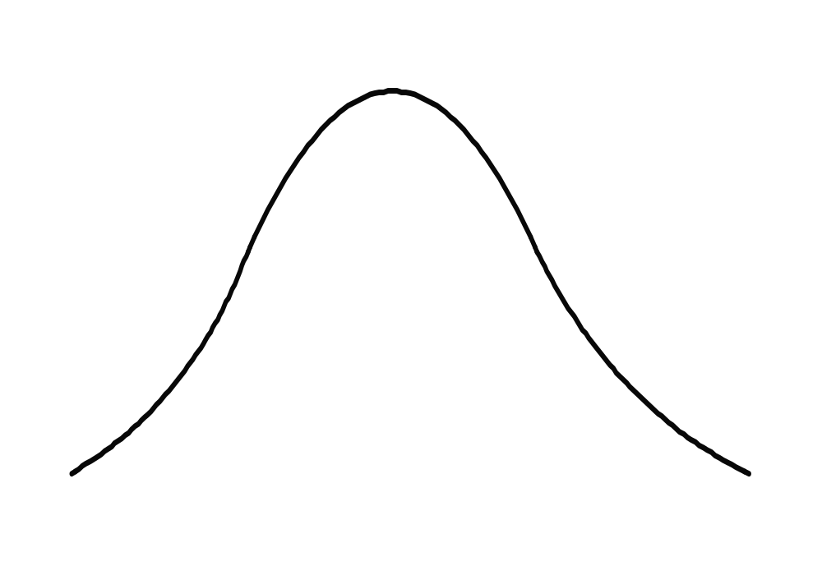
Reorder Point
Figure 11.13
The ROP based on a normal
Distribution of lead time demand
Service level
Risk of
a stockout
Probability of
no stockout
Expected
demand
ROP
Quantity
Safety
stock
0
z
z-scale

Slide 36
Fixed-Order-Interval Model
Orders are placed at fixed time intervals
Order quantity for next interval?
Suppliers might encourage fixed intervals
May require only periodic checks of inventory levels
Risk of stockout

Slide 37
Fixed-Interval Benefits
Tight control of inventory items
Items from same supplier may yield savings in:
  Ordering
  Packing
  Shipping costs
May be practical when inventories cannot be closely monitored

Slide 38
Fixed-Interval Disadvantages
Requires a larger safety stock
Increases carrying cost
Costs of periodic reviews

Slide 39
Single Period Model
Single period model: model for ordering of perishables and other items with limited useful lives
Shortage cost: generally the unrealized profits per unit
Excess cost: difference between purchase cost and salvage value of items left over at the end of a period

Slide 40
Single Period Model
Continuous stocking levels
  Identifies optimal stocking levels
  Optimal stocking level balances unit shortage and excess cost
Discrete stocking levels
  Service levels are discrete rather than continuous
  Desired service level is equaled or exceeded

Slide 41
Operations Strategy
Too much inventory
  Tends to hide problems
  Easier to live with problems than to eliminate them
  Costly to maintain
Wise strategy
  Reduce lot sizes
  Reduce safety stock

